Slide 1
Ускорение нейронных сетей

Slide 2
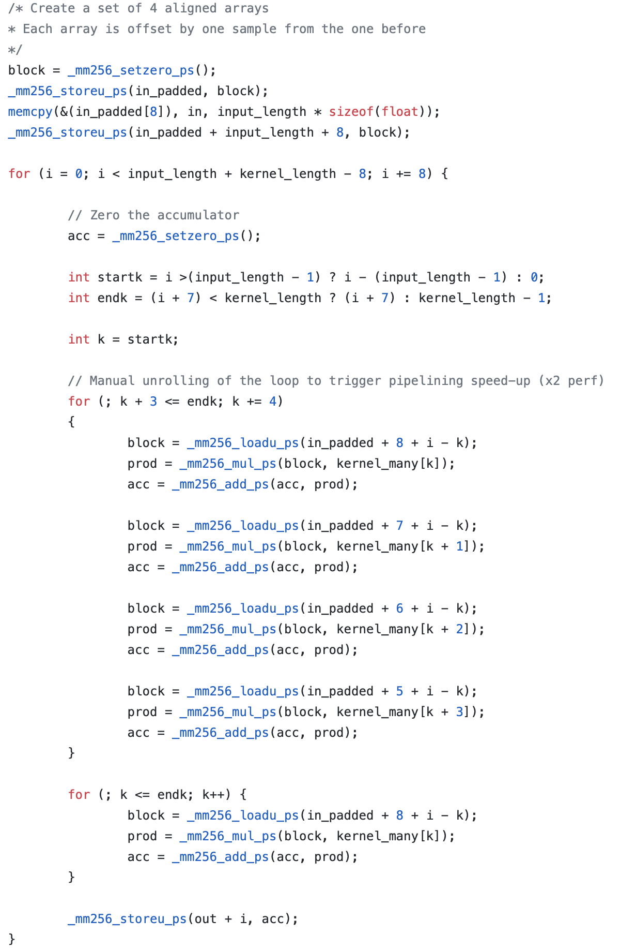
SIMD инструкции и многопоточность
https://gist.github.com/vermorel/7ad35212df44f3a79bca8ab5fe8e7622#file-fast_convolve_1d-cpp-L123

Slide 3
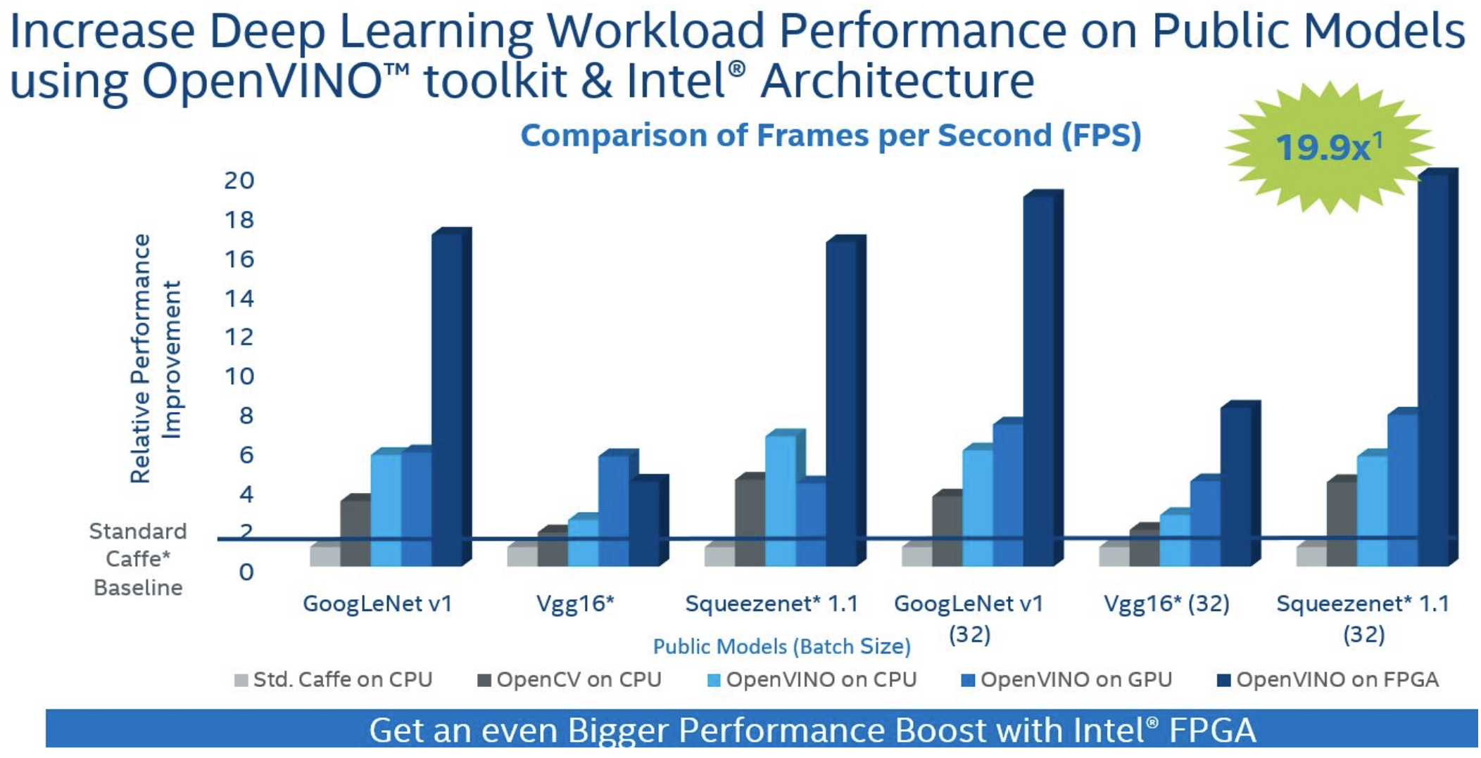
OpenVino

Slide 4
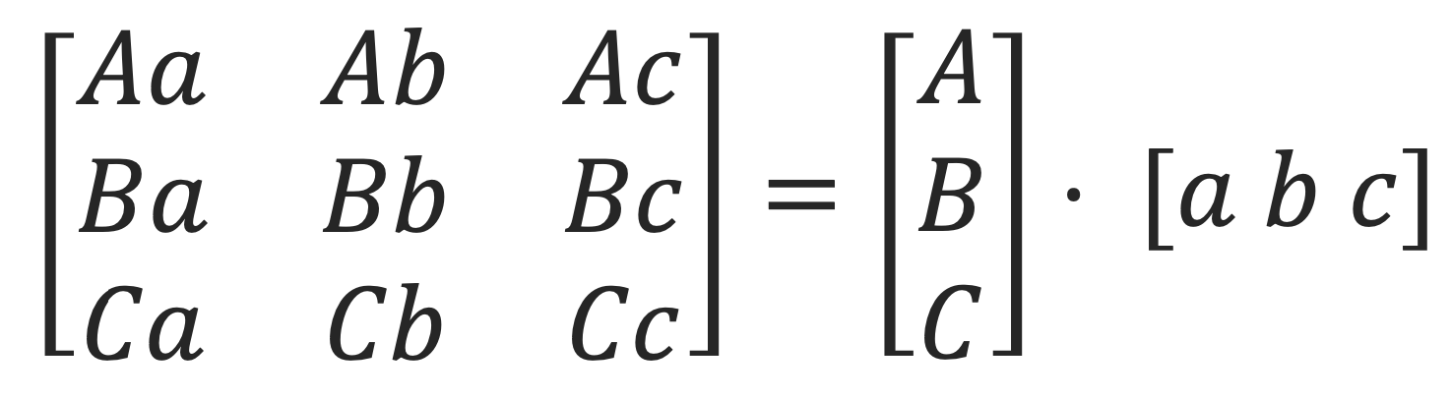
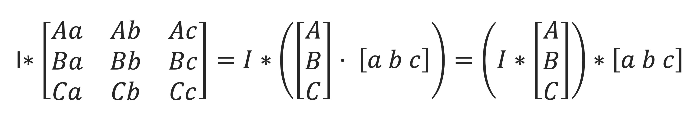

Сепарабельные фильтры
3x3xN – ReLU vs 3x1xN – ReLU – 1x3xN – ReLU:
T1=3*3*N*C*W*H +N*W*H vs T2=3*1*N*C*W*H+N*W*H+1*3*N*N*W*H+N*W*H
При N=C T1/T2=(9N+1)/(6N+2)≈1,5

Slide 5
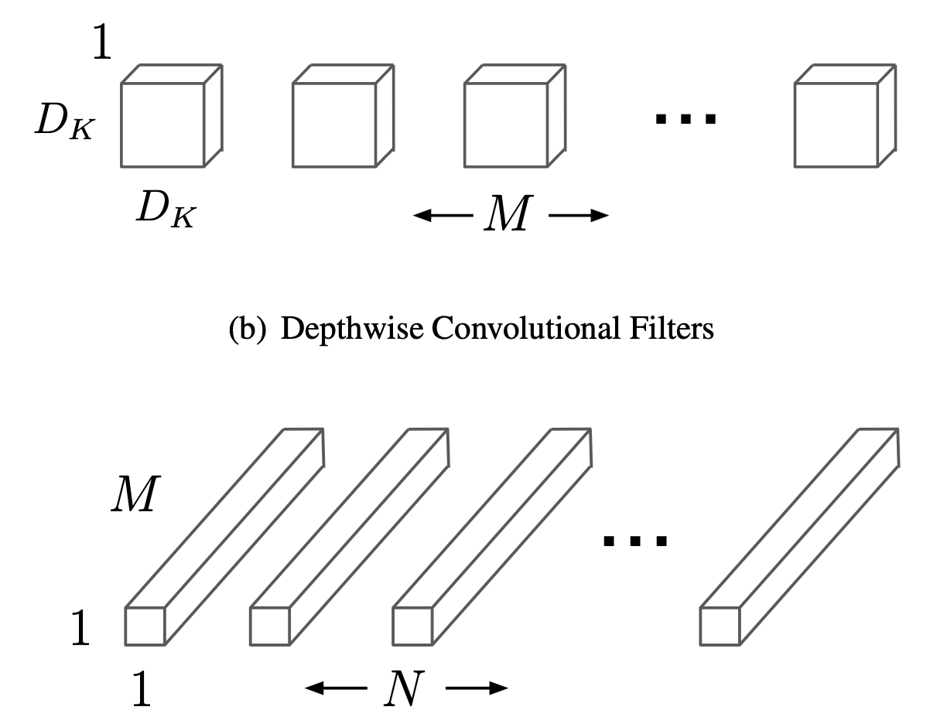
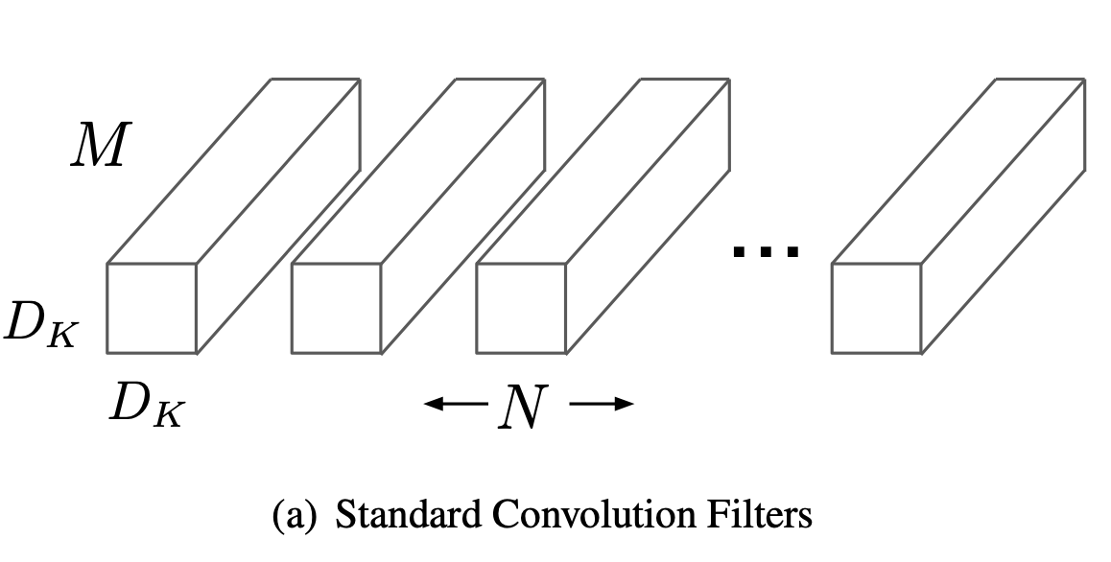

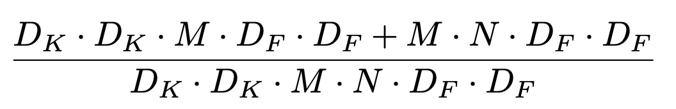
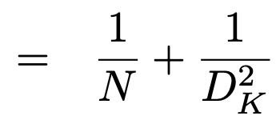
MobileNet
Howard, Andrew G., Menglong Zhu, Bo Chen, Dmitry Kalenichenko, Weijun Wang, Tobias Weyand, Marco Andreetto, and Hartwig Adam. "Mobilenets: Efficient convolutional neural networks for mobile vision applications." arXiv preprint arXiv:1704.04861 (2017). https://arxiv.org/pdf/1704.04861.pdf

Slide 6
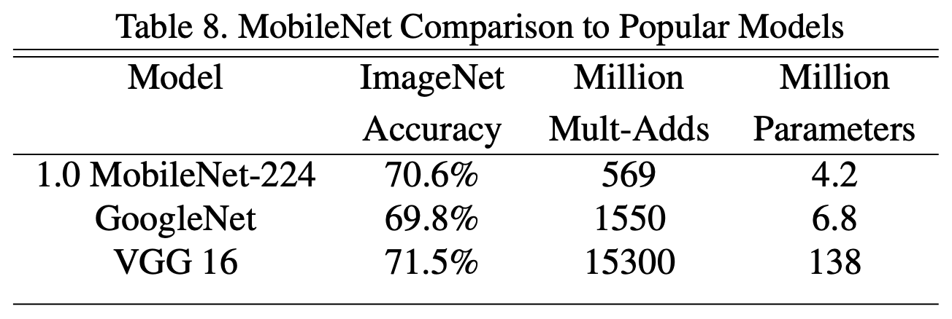
MobileNet

Slide 7
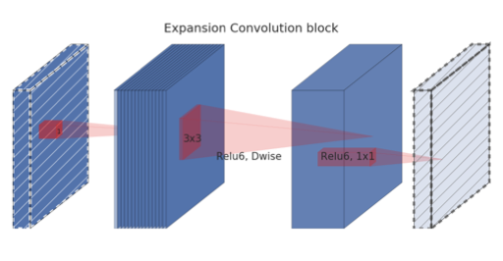
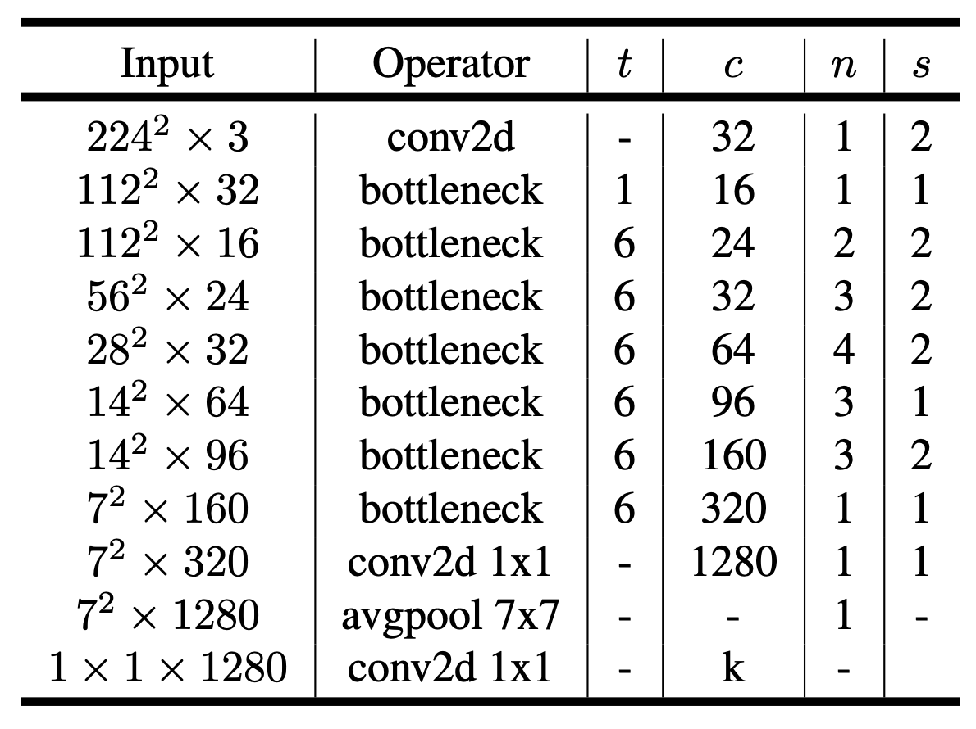
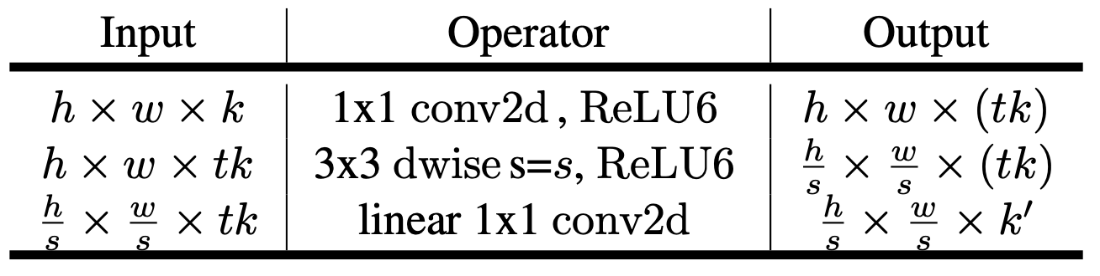
MobileNet v2
Sandler, Mark, Andrew Howard, Menglong Zhu, Andrey Zhmoginov, and Liang-Chieh Chen. "Mobilenetv2: Inverted residuals and linear bottlenecks." In Proceedings of the IEEE conference on computer vision and pattern recognition, pp. 4510-4520. 2018. https://arxiv.org/pdf/1801.04381.pdf

Slide 8
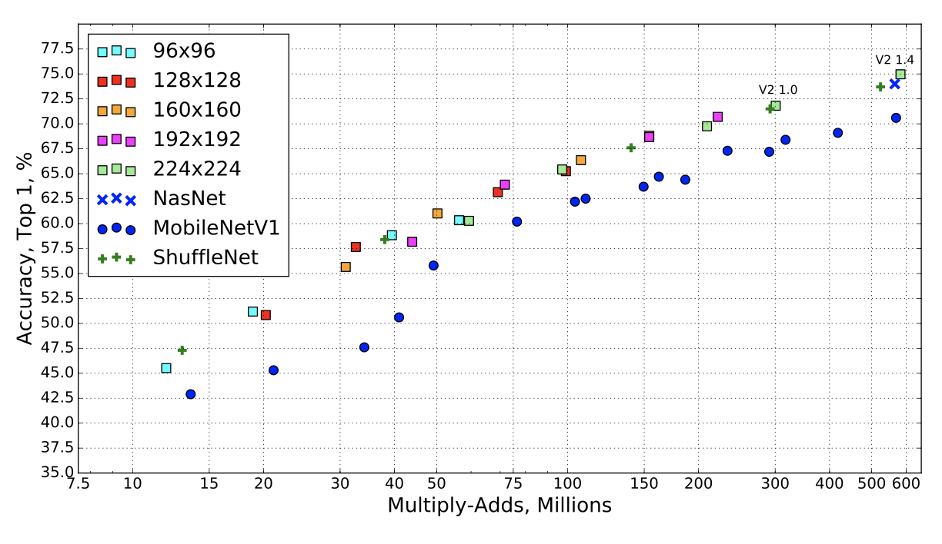
MobileNet V2

Slide 9
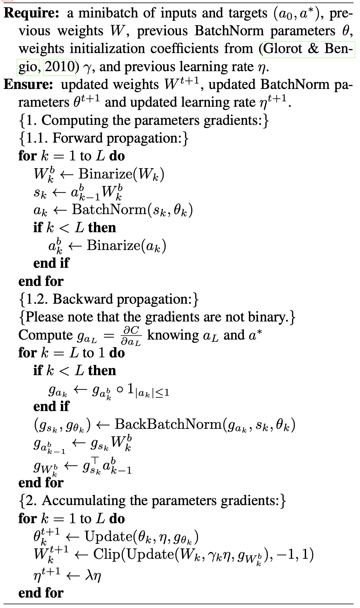
BNN
Courbariaux, Matthieu, Itay Hubara, Daniel Soudry, Ran El-Yaniv, and Yoshua Bengio. "Binarized neural networks: Training deep neural networks with weights and activations constrained to+ 1 or-1." arXiv preprint arXiv:1602.02830(2016). https://arxiv.org/pdf/1602.02830

Slide 10
BNN, реализация через инструкции

Slide 11
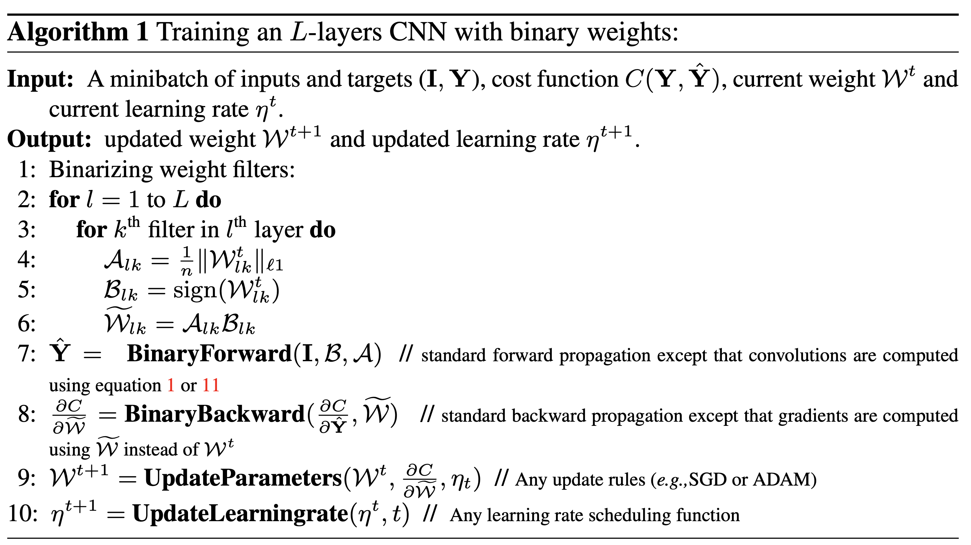
XNOR-net
Rastegari, Mohammad, Vicente Ordonez, Joseph Redmon, and Ali Farhadi. "Xnor-net: Imagenet classification using binary convolutional neural networks." In European conference on computer vision, pp. 525-542. Springer, Cham, 2016. https://arxiv.org/pdf/1603.05279.pdf

Slide 12
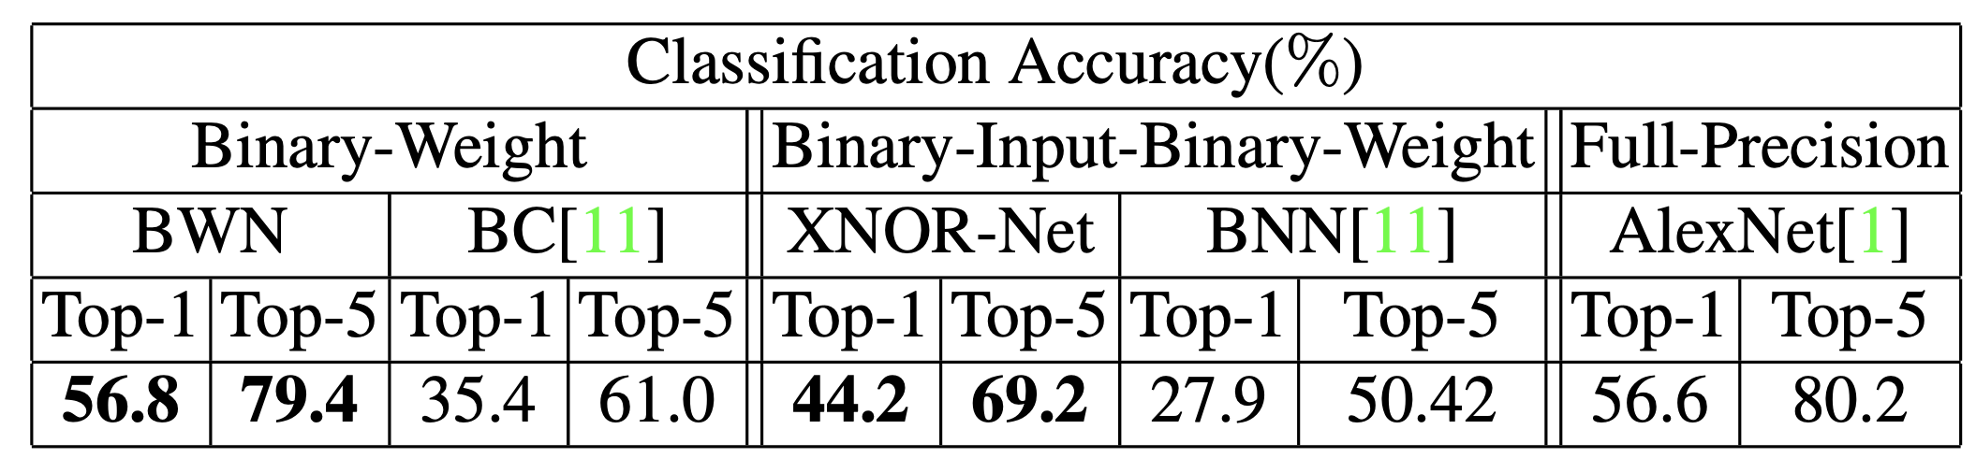
Результаты квантизации
Готовая реализация: MXNet, https://github.com/hpi-xnor/BMXNet

